Slide 1
The Hipster Mobile scale 1cm:60 inches

Slide 2
BEEN THE CAR OF THE FUTURE BEFORE IT WAS COOL TO BE THE CAR OF THE FUTURE
By:
Eric Cheng
Micky Harris
Lindsey Loeber
Noah Prochnow

Slide 3
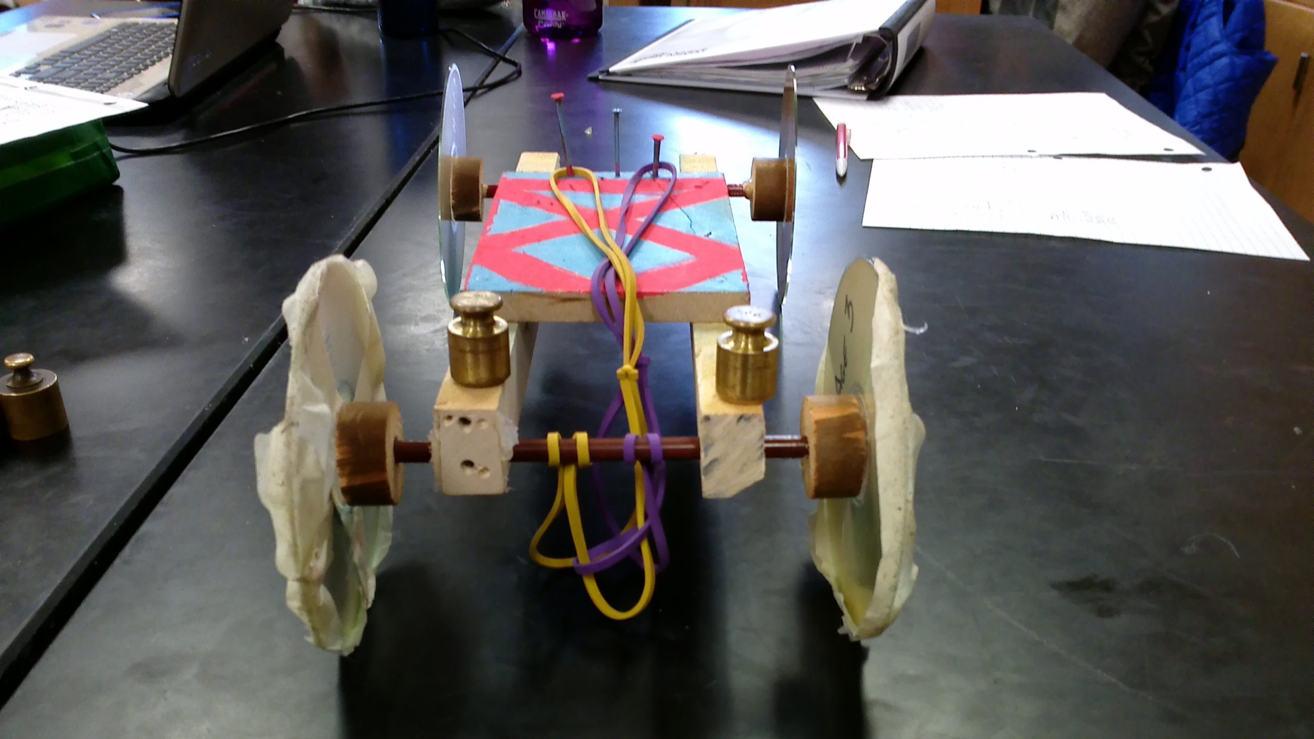
DESIGN
The prototype has a sleek wooden frame and customizable colored pencil axle. The wheels are made of chrome compact discs and the engine is made out of rubber bands containing the highest quality of natural rubber and latex.

Slide 4
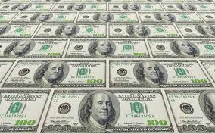
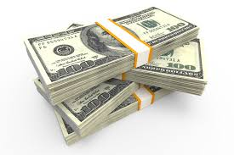
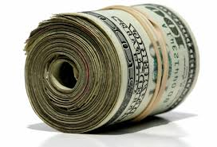
The cost
2 colored pencils $0.60
4 cds $1.60
2 pieces of 31cm X 2cm wood $1.00
1 piece of 10cm X 15 cm wood + $1.00
$4.20
Insane paint job $priceless

Slide 5
Price of Refueling
Annual price
Gas car: $2,ooo.00
Electric car: $1,000.00
Hipster mobile:

Slide 6
FREE!!!!!!!!!!!!!!!!!!!!!!!!!!!!!!!!!!!!!!!!!!!!!

Slide 7
Transfer of energy

Slide 8
Acceleration
1 meter: 1.28m/s 3 meter: 0m/1s 5 meter deceleration: .24m/ 1s
2 meter: 0.17m/s 4 meter: 0.57m/s
Our engineers put an adhesive substance on the wheel to maintain max traction without wasting energy.

Slide 9
Top speed
Model Hypothetical car
1.45m/s 34.28m/s
Or Or
3.24 MPH 76.6 MPH
0-60 in 1.88s

