Slide 1
Porifera Presentation
A window into the diverse world of sponges

Slide 2
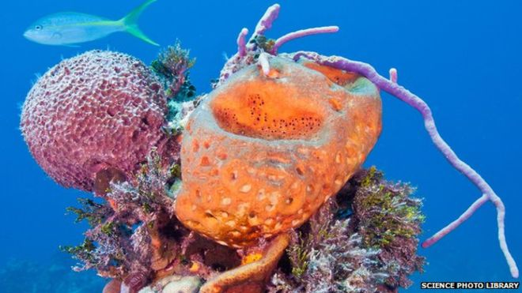
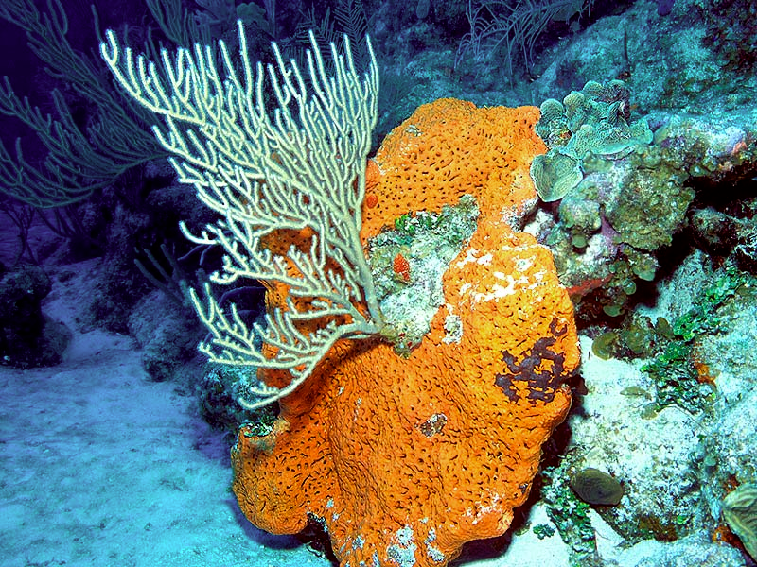
How Porifera Benefits Coral Reefs
-The article is about how sponges benefits the coral reefs by creating a healthy reef ecosystem.
-Importance: Marine sponges live on the bottom of the ocean, and are an important component for a healthy reef ecosystem.
-Essential Facts: They are filter feeders, and pull nutrients out of the water, leaving the water crystal clear. Then they redistribute the water to the reefs.

Slide 3
Importance of Sponges
An estimated 60% of reefs are threatened by human activities such as coastal development and pollution. Global warming is an additional threat for the reefs.
Sponges recycle almost 10 times as much matter as bacteria. They also produce as much nutrition as all of the corals and algae in the reefs combined.
Reefs release nearly half of their organic matter into sea water, they need something that can recover, and redistribute/recycle these nutrients, which is exactly what sponges do.
I would like to know more about how sponges may affect other marine life.

Slide 4
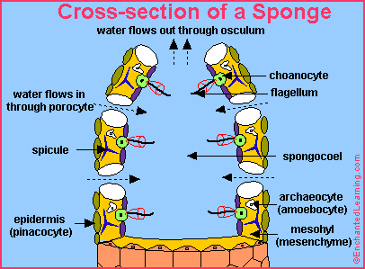
Sponges Anatomy and Diet
The body of a sponge has two outer layers separated by an acellular gel layer called the mesohyl, In the gel layer there are either spiracles (supportive needle made from calcium carbonate) or spongin fibers (a flexible skeleton material made from protein)
Sponges have neither tissues nor organs
They can range in from a few millimeter to 2 meters tall.
Different sponges have different shapes, including tubes, fans, cups, cones, blobs, barrels, and crusts.
Sponges are filter feeders that eat tiny, floating organic particles and plankton that they filter from the water that flows through their body.
Food is collected in specialized cells called choanocytes and brought to other cells by amoebocytes.

Slide 5
Global Diversity of Porifera
My article was about the diversity and spread of the phylum Porifera around the world. The scientists determined which parts of the globe have more diversity in their Poriferan populations, as well as which types of sponges are most common in which regions.
This article is very important and has been cited dozens of times because it allows other scientists to know where they can find different types of sponges for further research. It is very interesting because it includes graphics which identify where sponges are the most diverse.

Slide 6
Global Diversity, Cont.
The most important fact that this article is that sponges are more diverse in areas with warm water. This explains why Poriferans are not as common or diverse near the poles and on the west coast of South America. Another important discovery in this article is that Demospongiae, or sponges with siliceous spicules, make up 90% of sponge species today.
I would like to learn more about when sponges diverged from other animal phyla. Some scientists think that they evolved independently, but there has not been enough research to confirm or deny this.

Slide 7
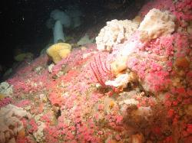
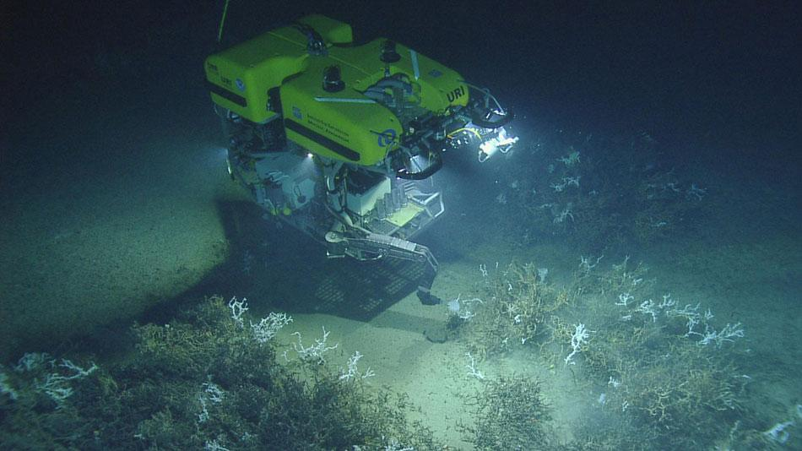
How Sponges Help Us
Florida Atlantic University. "Scientists use new 'tool sled' to collect sea sponges that have potential to combat various diseases." ScienceDaily, June 3 2015: http://www.sciencedaily.com/releases/2015/06/150603093728.htm
Sponges produce a chemical- either a natural product or secondary metabolite- called psammaplin A
Chemicals don’t sustain life, but help develop advantages for the next generation of organisms example: To prevent from being eaten, sponges excrete a chemical that is toxic, so the predator knows that they taste bad. This could benefit the producing organism
Chemicals like mentioned above are created with similar genes/ DNA code as several cancers and Alzheimer’s disease, and can stop or delay the growing and dividing of cancerous cells
With similarities, people can find a possible cure, or create medicine to ease the pain

Slide 8
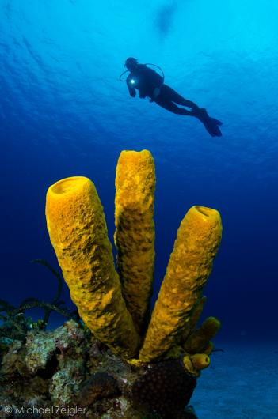
How Sponges Help Us, Cont’d
Summary and Reflections I had:
The article was about sponges having a possible treatment for cancer
or other infectious diseases
Importance: This is very important and interesting because we know that cancer has a huge effect on society, and is very dangerous.
Essential Facts: Sponges excrete a chemical called psammaplin A that defends them from predators. This chemical is found to possibly stop cancerous cells from growing and dividing
Reflection: I would like to know whether they have created any medicines or drugs with their findings on sponges and cancer yet

Slide 9
Citations
Global Diversity of Sponges: Van Soest RWM, Boury-Esnault N, Vacelet J, Dohrmann M, Erpenbeck D, De Voogd NJ, et al. (2012) Global Diversity of Sponges (Porifera). PLoS ONE 7(4): e35105. doi:10.1371/journal.pone.0035105
Sponge anatomy and diet: http://www.enchantedlearning.com/subjects/invertebrates/sponge/
Science Daily: University of Maryland Center for Environmental Science. "Bacteria in marine sponges harvest phosphorus for reef community." ScienceDaily. ScienceDaily, 23 February 2015. <www.sciencedaily.com/releases/2015/02/150223164436.htm>.
Morgan, James. "Sponges Help Coral Reefs Thrive in Ocean Deserts - BBC News." BBC News. N.p., 7 Oct. 2012. Web. 30 Sept. 2015. <http://www.bbc.com/news/science-environment-24398394>.
Powell, Abigail, David J. Smith, Leanne J. Hepburn, Timothy Jones, Jade Berman, Jamaluddin Jompa, and James J. Bell. "Reduced Diversity and High Sponge Abundance on a Sedimented Indo-Pacific Reef System."PLoS ONE. Public Library of Science, 24 Jan. 2014. Web. 30 Sept. 2015. <http://www.ncbi.nlm.nih.gov/pmc/articles/PMC3901660/>.
Florida Atlantic University. "Scientists use new 'tool sled' to collect sea sponges that have potential to combat various diseases." ScienceDaily, June 3 2015: http://www.sciencedaily.com/releases/2015/06/150603093728.htm

